Slide 1
Software Engineering CS20006
Lecture 14
Function-Oriented Design Approach
(Structured Design)

Slide 2
Lecture #14
Structured Design
Structure chart
Basic building blocks in structure chart
Deriving the structure chart from DFD
Transformation analysis
Transaction analysis
Structure chart vs. Flow chart

Slide 3
Structured Design Technique

Slide 4
Structured Design
SD represents the software architecture at a detailed level than SA
Output of SA is input to SD
SD captures
Various modules making up the system
The modular dependency (which module calls which other modules etc.)
Parameters passed among the modules
SD never focus on the procedural aspects but only the design
SD provides direct input to the coding team
Implementation of the system using some programming language

Slide 5
Structure Chart
The major tool used in the structured design to depict the structure of a system is the structure chart (SC)
There are three main components in the structure chart
Modules
Connection between modules, and
Communication between modules

Slide 6
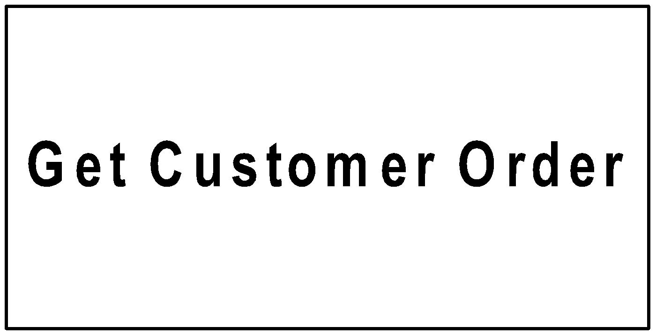
Basic Building Blocks in SC
Rectangular box
A rectangular box represents a module
It is always annotated with the name of the module it represents
Example

Slide 7
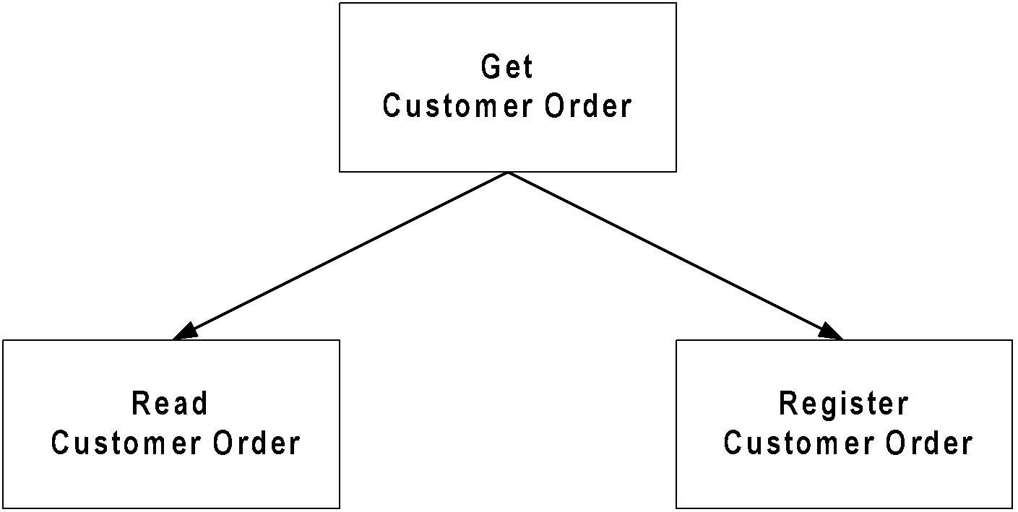
Basic Building Blocks in SC
Module invocation arrow
An arrow connecting two modules (rectangular boxes)
It represents the control passing from one module to another
Example

Slide 8
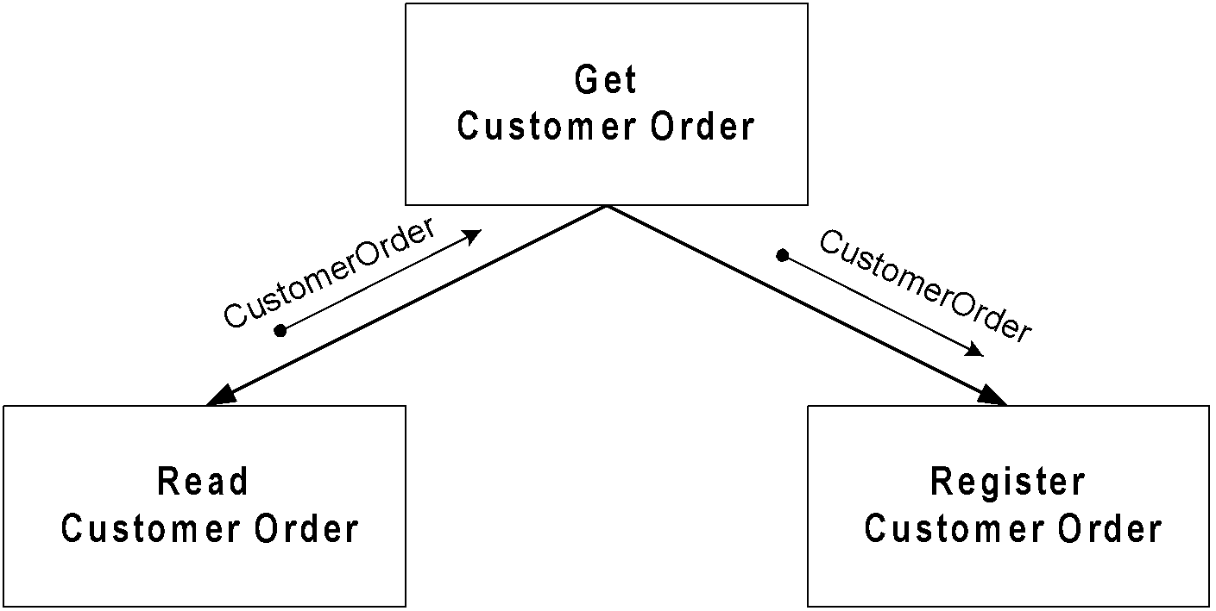
Basic Building Blocks in SC
Data flow arrow
To represent the data passes from one modulo to the other in the direction of arrow
Small arrow appears alongside the modulo invocation arrow
It is annotated with the corresponding data name
Example

Slide 9
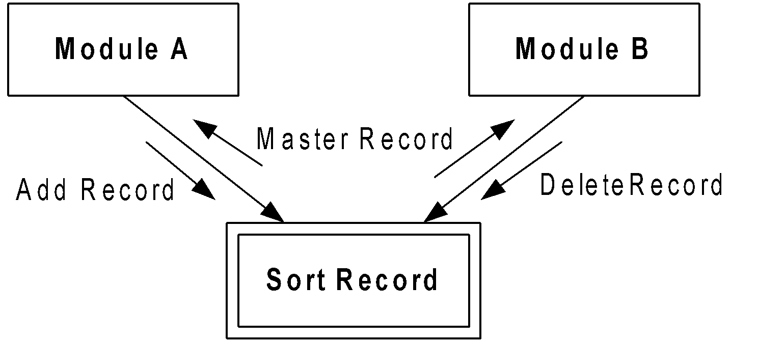
Basic Building Blocks in SC
Library Modules
To represent frequently called modules
When a module is invoked by many other modules it is treated as a library module
It is denoted by a rectangle with double edges
Example

Slide 10
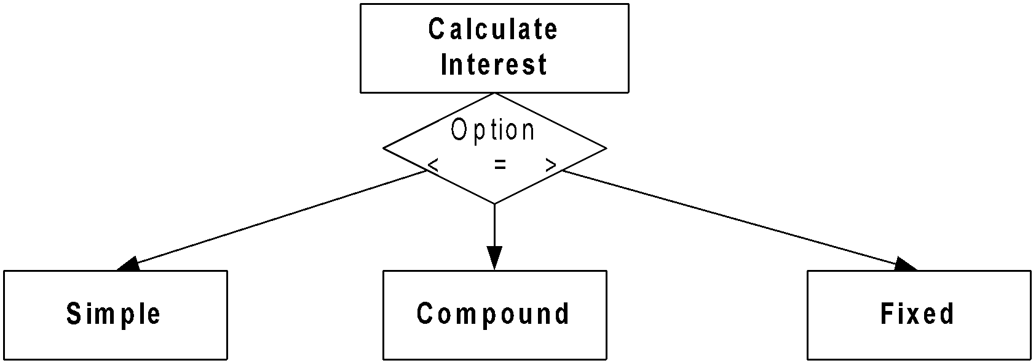
Basic Building Blocks in SC
Decision
To represent a selection out of many options
It is denoted by a diamond symbol
One module out of several modules connected with the diamond symbol is invoked depending on the condition attached to the diamond symbol
Example

Slide 11
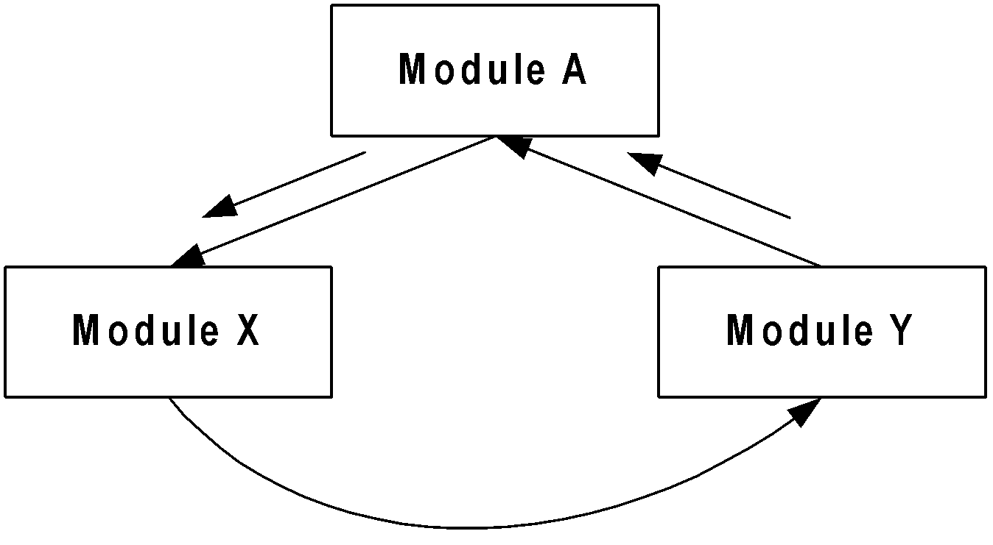
Basic Building Blocks in SC
Iteration
To represent a repetition when two or more modules are invoked repeatedly
It is denoted by a control flow with loop
Example

Slide 12
Deriving the Structure Charts
A systematic technique should be followed to transform the DFD representation of a problem into a structure chart
From structure analysis obtain the final version of DFD
Two strategies are know for transforming DFD into a structure chart
Transform analysis
For a large classes of data when same process is applied
Usually at higher levels of DFD
Transaction analysis
For a given data several possible paths are there in the DFD
Usually at a lower level of DFD

Slide 13
Deriving the Structure Charts
Start with the level 1 DFD
Transform the level 1 DFD into module representation using either the transform analysis or transaction analysis and then proceed towards the lower level DFD
It is necessary to first determine whether the transformation analysis or transaction analysis is applicable to a particular DFD (level diagrams)
It is not necessary to have a single structure chart for a given DFD model
Depending on the size and complexity of a problem, a structure chart can be build up with more than one chart but following a hierarchical relationship from a predecessor to its successors

Slide 14
Deriving the Structure Charts
Whether the transform analysis or transaction analysis is applicable it can be decided from the data input to the DFD
Transform analysis is applicable when all the data flows into the diagram are processed in similar ways
For example, a number of data are incident on the same bubble
Transaction analysis is applicable when same data but process in different ways
For example, same data goes to a number of bubbles

Slide 15
Transformation Analysis
Transform analysis identifies the primary functional components and high level input and outputs for these components
There are three steps in the transformation analysis:
First step.
Divide the DFD into three parts
Afferent branch
The input portion that transform input data from physical (e.g. reading from a source) to logical (storing into a table)
Efferent branch
The output portion that transform output data from logical form (e.g. output from a process) to physical form (e.g. display the result)
Central Transform
The remaining portion of the DFD

Slide 16
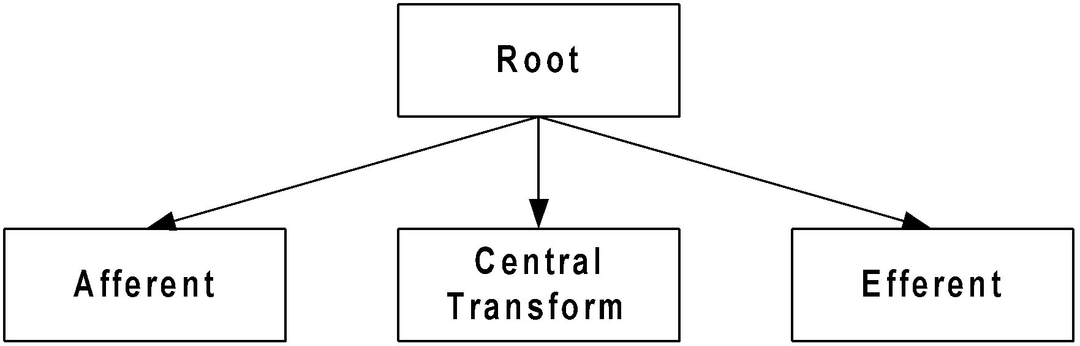
Transformation Analysis
Second step.
Derive the structure chart by drawing on module for each of the afferent branch, central transform, and the efferent branch
They are drawn below a module called the root module which invokes these modules
Example

Slide 17
Transformation Analysis
Third step.
Refine the structure chart by adding sub modules required by each of the high-level functional components
Factoring
Process of breaking functional components into subcomponents is called factoring
The factoring process should be repeated until all bubbles in the DFD are represented in the structure chart

Slide 18
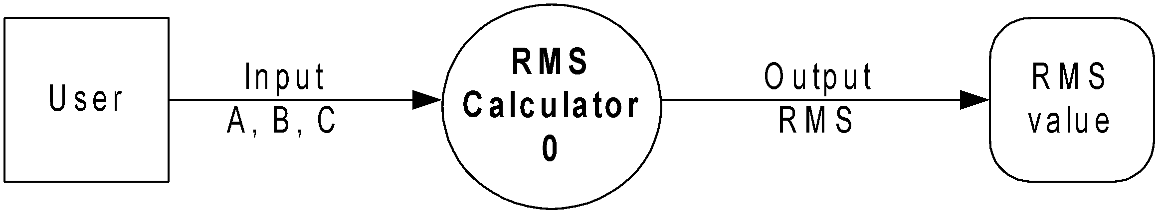
Transformation Analysis: An Example

Slide 19
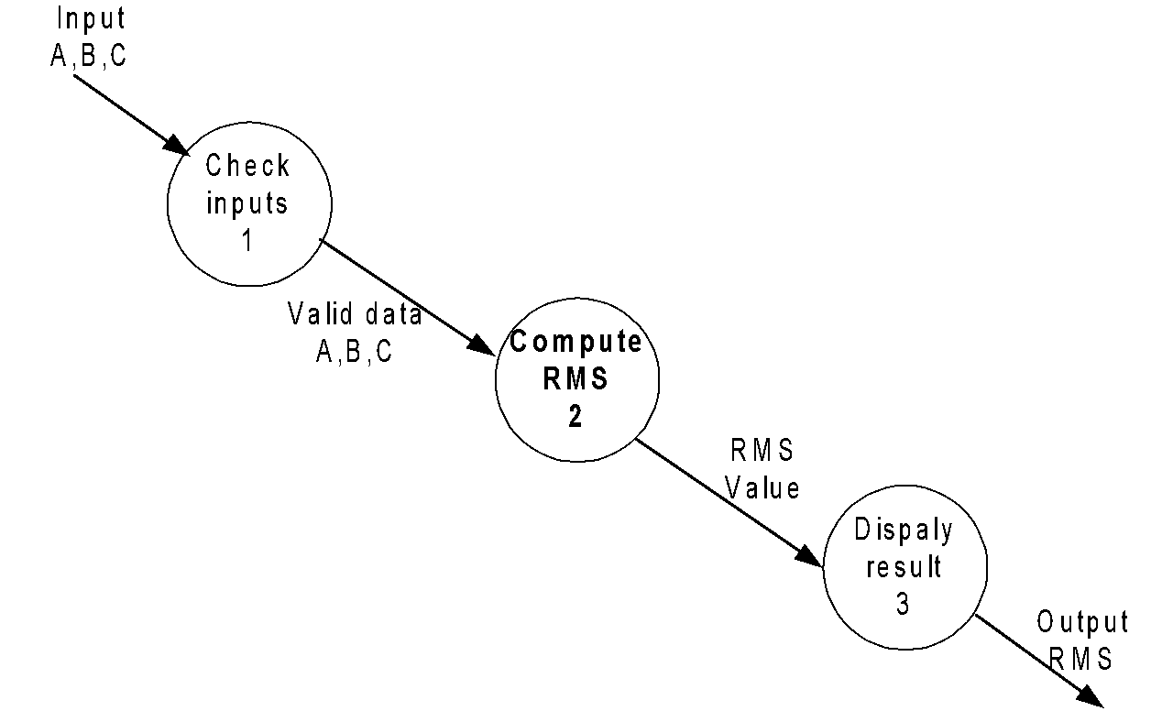
Transformation Analysis: An Example

Slide 20
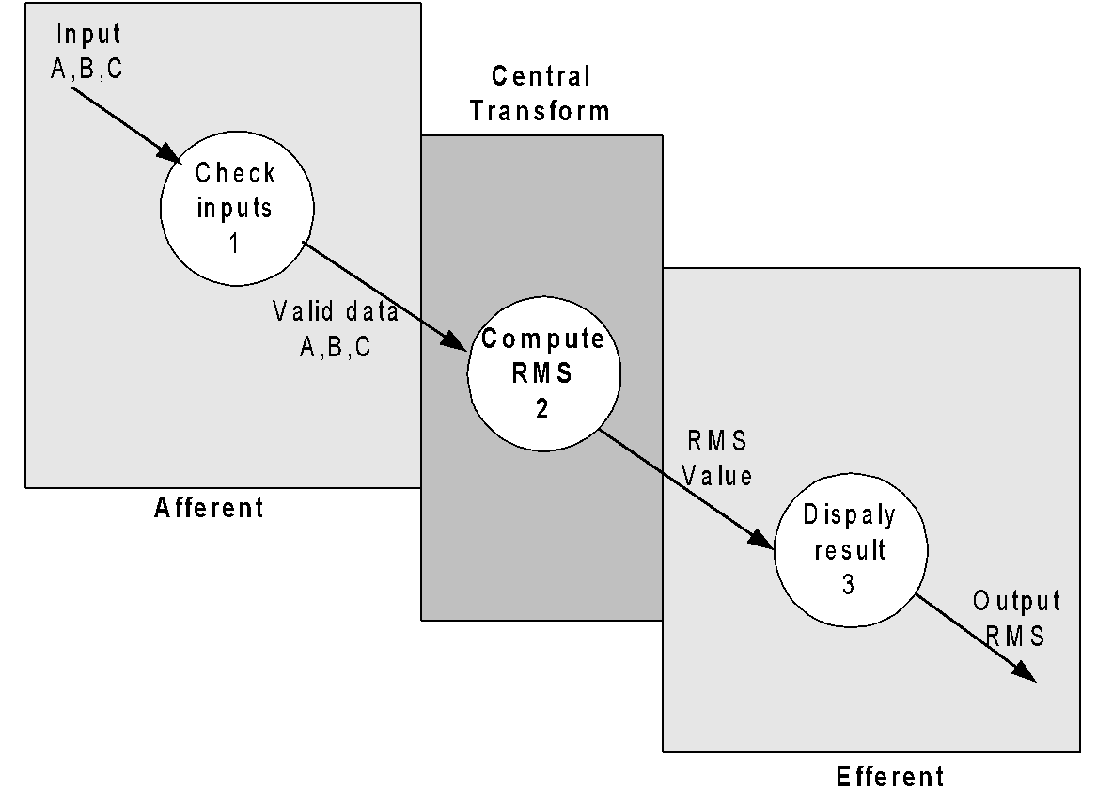
Transformation Analysis: An Example

Slide 21
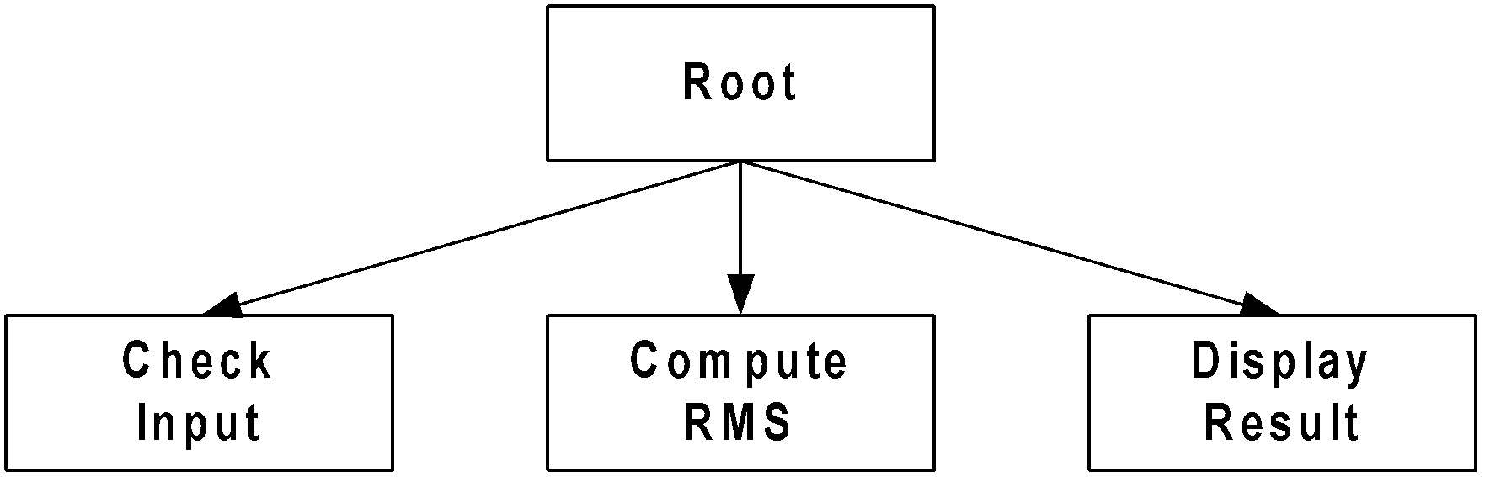
Transformation Analysis: An Example

Slide 22
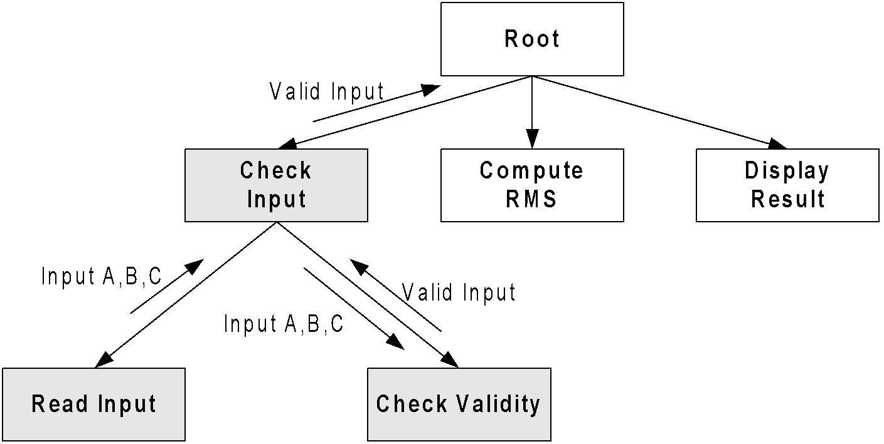
Transformation Analysis: An Example

Slide 23
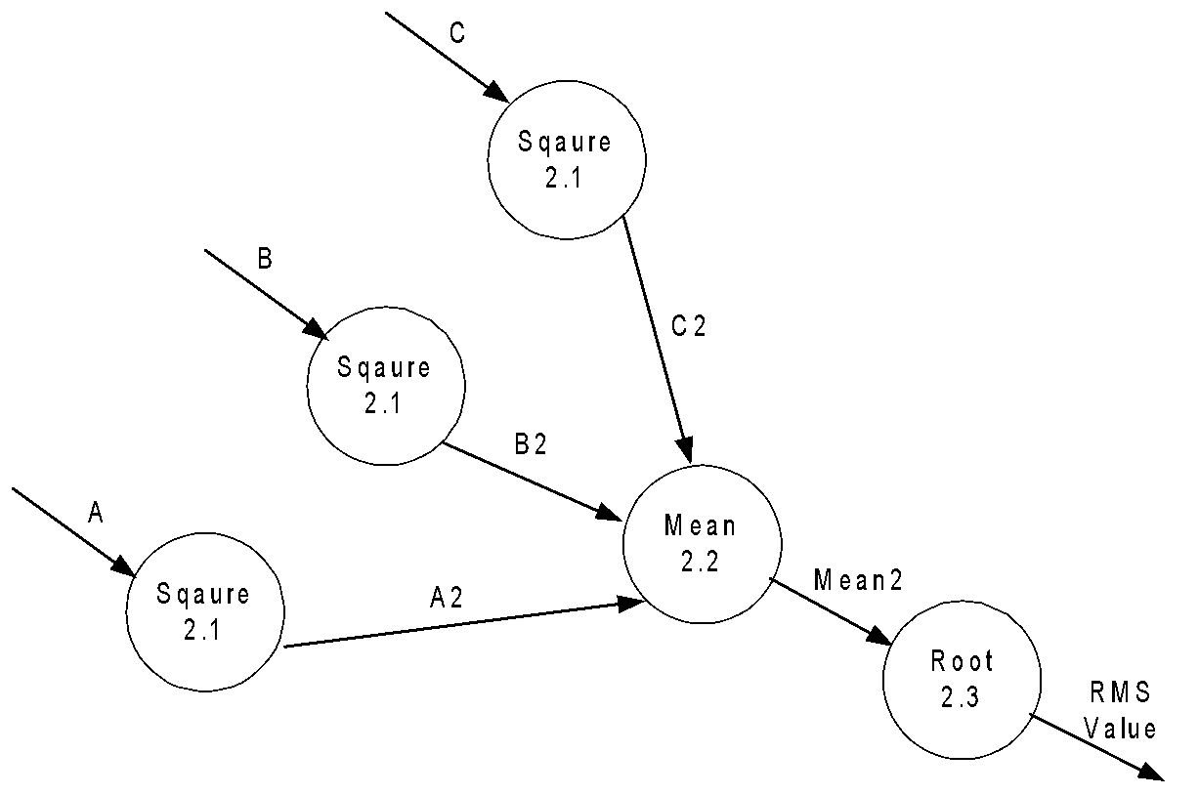
Transformation Analysis: An Example

Slide 24
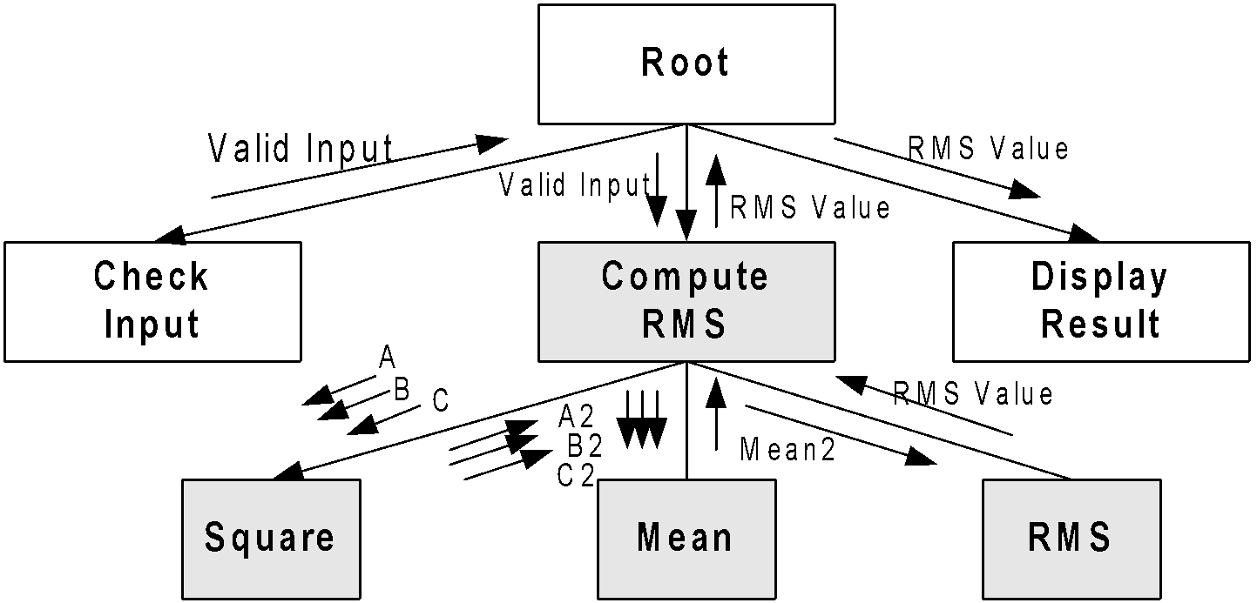
Transformation Analysis: An Example

Slide 25
Transaction Analysis
Transformation analysis is suitable for transforming central system, which is characterized by identical processing steps for each data items
Transaction analysis is suitable for transaction-driven system which is characterized by several possible paths are to be traversed through the DFD depending on the input data item
The number of bubbles on which the input data to the DFD are incident defines the number of transactions
However, some transactions may not require any input data

Slide 26
Transaction Analysis
Identify a transaction by tracing the path from an input data to output data
All traversed bubbles belong to the transaction
These bubbles is to be mapped to a module in the structure chart
There will be root module under which all modules identifying transactions will be drawn
Every transaction carries a label identifying its functionality
A transaction can be refined to its more detailed level (sub-modules)

Slide 27
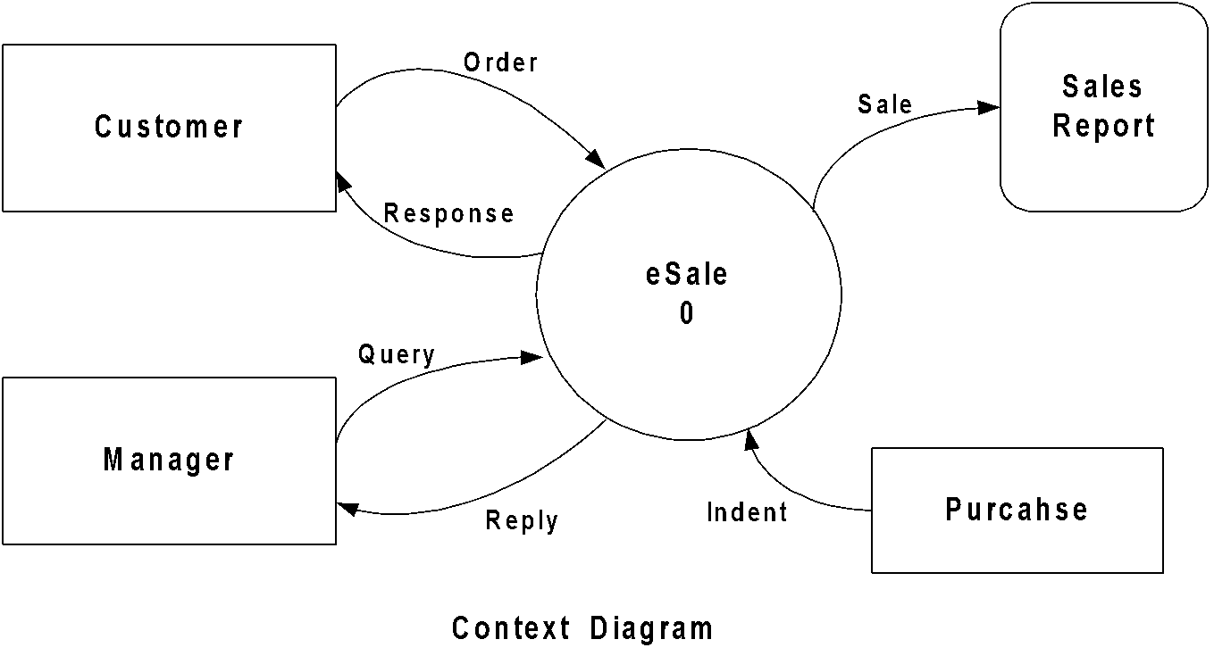
An Example of Transaction Analysis: eSale

Slide 28
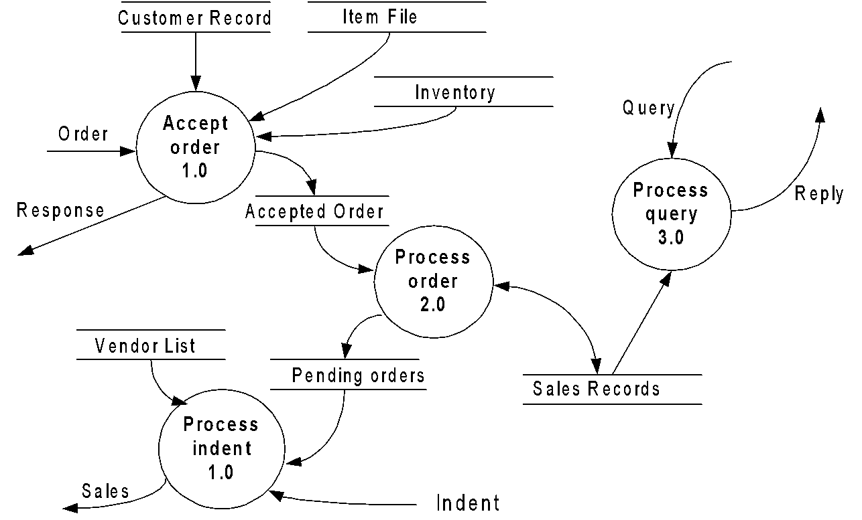
An Example of Transaction Analysis: eSale

Slide 29
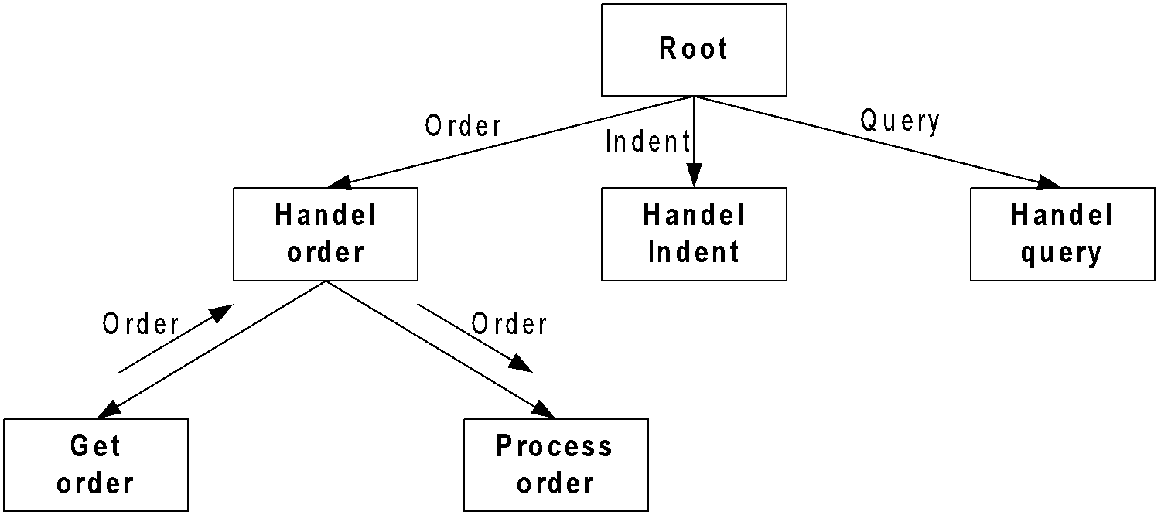
An Example of Transaction Analysis: eSale

Slide 30
Structure Chart vs. Flow Chart
SC – Identify different modules of the software
FC - Identify the control of execution of a program
SC - Represent data interchange among different
modules
FC – Technique to represent the flow of control
SC – Not able to depict ordering of tasks
FC – Depicts the ordering of tasks

Slide 31
Problems to Ponder
What things further you can add into the DFD and SC to make it more useful?
Decide some parameters which can be taken as a basis for evaluating a design
Can you find any “rule of thumb” to guide the design team relating LOC (or FP, AP) and number of design pages (work volume)?

